Slide 1


WELCOME TO ACCOUNTANTCHANGE HACKATHON
17 November 2023

Slide 2

About Tailored Accounts
Founded by Harry Hoang in 2008, Tailored Accounts is now one of Australia’s leading management accounting and consulting companies, with offices located in Brisbane, Sydney, Goulburn and Canberra.
Services:
Management & compliance accounting, taxation.
Cloud integration;
Business advisory.
Clientele – more than 200 companies and not for profit associations throughout Australia.

Slide 3

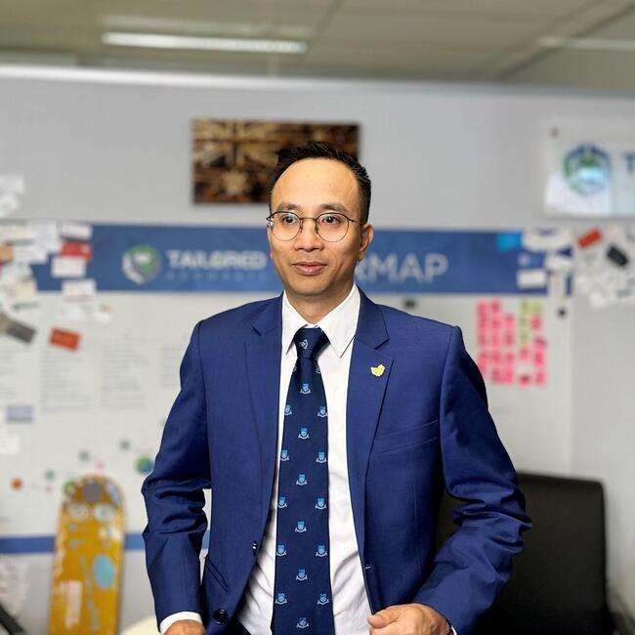
Harry Hoang
FCPA FIPA MAICD Tax Agent
CEO and Founder of Tailored Accounts since 2008.
Fields of Interest:
Accounting;
Start-up mentorship;
Business coaching.
Current volunteer positions:
Organiser of AccountantChange Training Program;
Mentor at The Mill House Accelerator Program;
Business coach and sponsor at Innovation ACT;
Mentor at the Griffin Accelerator Start-up Program.

Slide 4

Introducing:
The Double Entry Dilemma

Slide 5
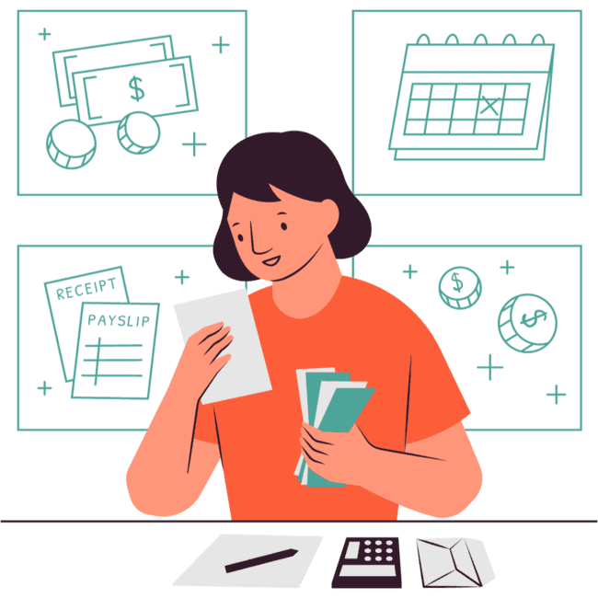
Double Entry
Double entry is a bookkeeping and accounting method, which states that every financial transaction has equal and opposite effects in at least two different accounts. ​

Slide 6
Pros & Cons of Double Entry
Pros | Cons
Highly Accurate Financial Records | Complex
Detailed Insights into Income and Expenses | Time-Consuming
Meets Regulatory Requirements i.e. auditors, investors, and regulators. | Steep Learning Curve
Transparent & Easy Analysis of Financial Performance. | More Expensive & Resource Heavy
Security Against Fraud | Doubles Your Book Size
Customisable for Business Needs | May Not be Affordable for Small Businesses

Slide 7
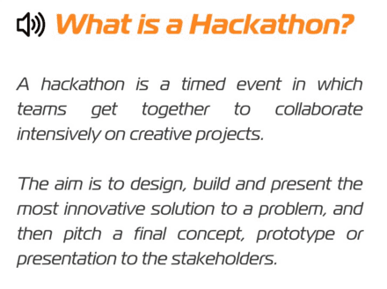

Slide 8
Hackathon Rules & Instructions
In teams of 3, you’ll have 1 hour to discuss and design a solution to the challenge
After the break, the teams will get 90 seconds to pitch their solution to the judges
The team with the best pitch will win a small prize
TIPS:
If you’re stuck or need some help with any technical issue, ask our staff for help
Feel free to use the resources available to you (i.e. the internet!)
Look outside the box
Remember, there is no “right” or “wrong” answer!

Slide 9
Get in Teams of 3!

Slide 10

Hackathon Begins Now!
Challenge
How can we “hack” the double-entry system?
How can we keep things simple and reduce the storage for double data?

Slide 11



Break Time!
Coffee, Tea & Cookies are available outside

Slide 12

Start Your Pitches

Slide 13

And the Winner is…

Slide 14

Thank You

Slide 15

Follow us
@AccountantChange
@Tailored Accounts
@AcctChange2018
@Tailored Accounts

