Slide 1
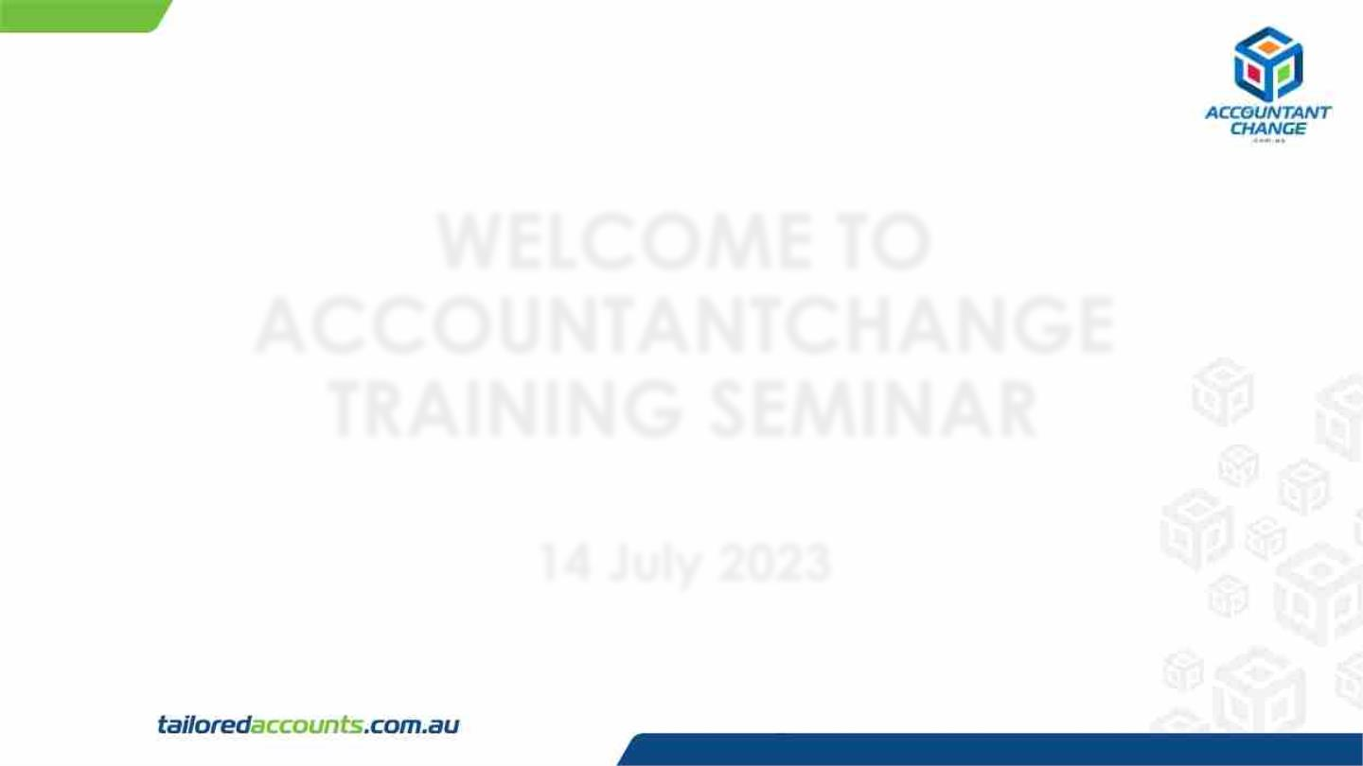
WELCOME TO
ACCOUNTANTCHANGE
TRAINING SEMINAR
14 July 2023

Slide 2
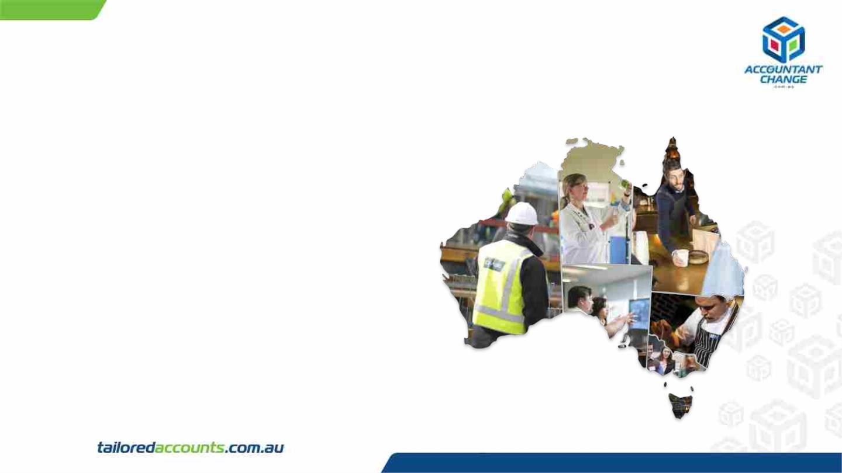
About Tailored Accounts
Founded by Harry Hoang in 2008, Tailored Accounts is
now one of Australia’s leading management
accounting and consulting companies, with offices
located in Brisbane, Sydney, Goulburn and Canberra.
Services:
✔Management & compliance accounting, taxation.
✔Cloud integration;
✔Business advisory.
Clientele – more than 200 companies and not for profit
associations throughout Australia.

Slide 3
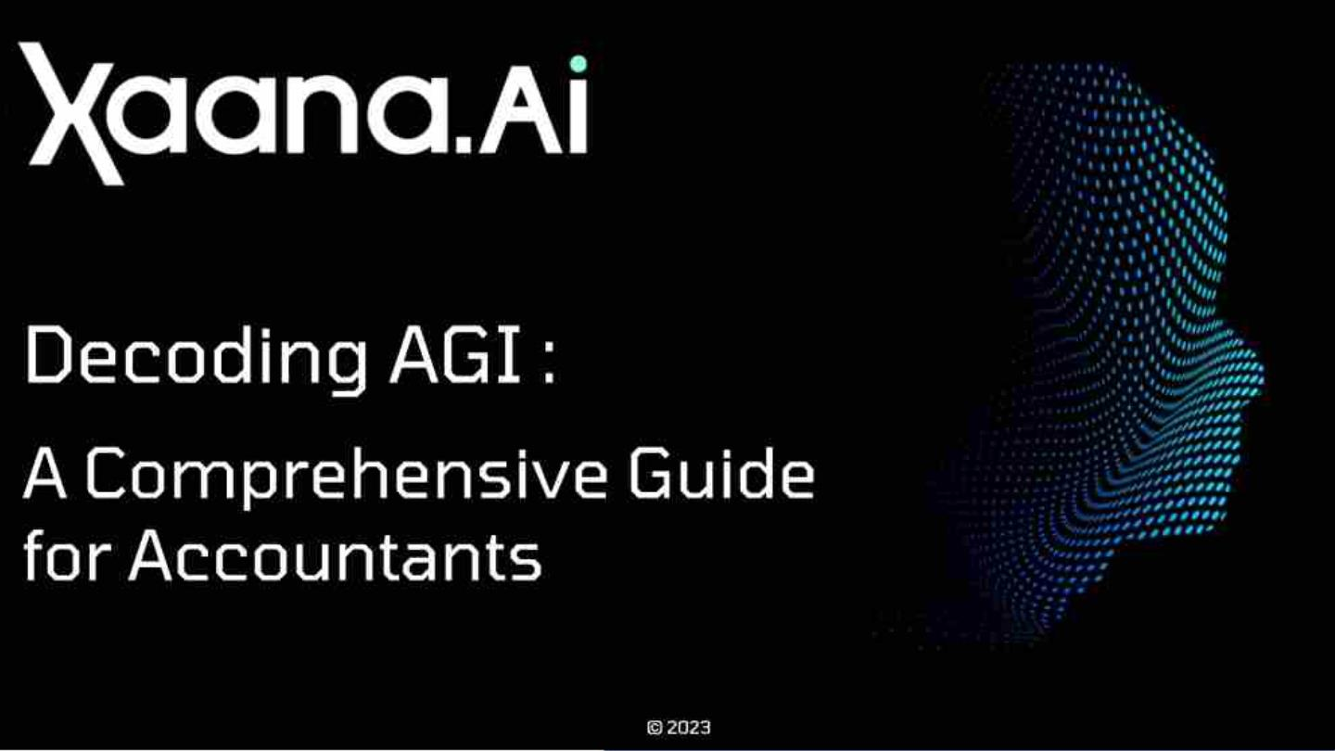

Slide 4

About The Speaker

Slide 5
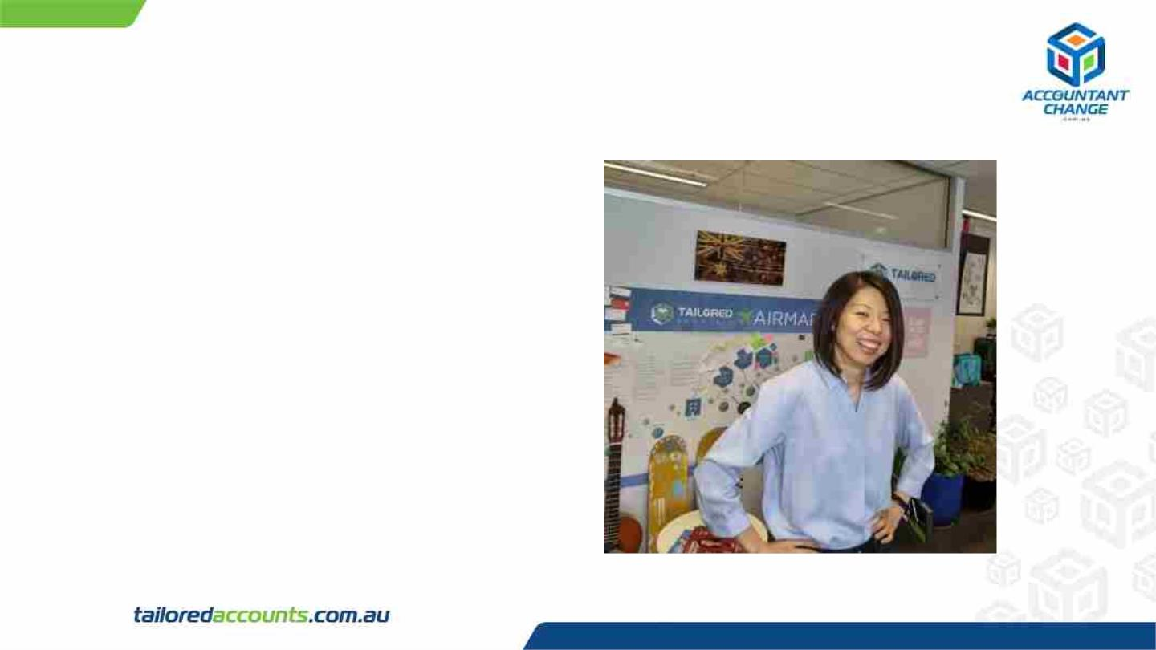
Fuzuki Nishimura
Chief Technical Advisor at Tailored Accounts.
Professional experience:
✔ Over 10 years of experience in Accounting.
✔ Former teacher.
Passions:
✔ Gym
✔ Skiing
✔ Saxophone
✔ Beer

Slide 6
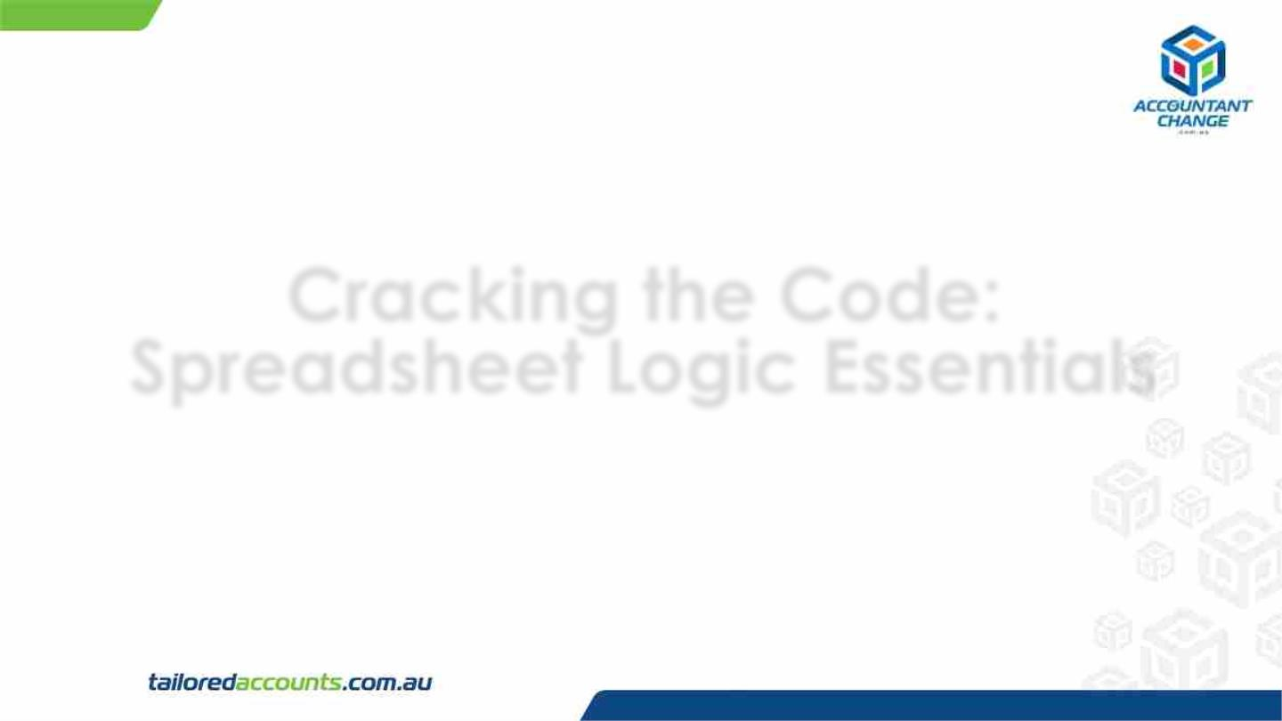
Cracking the Code:
Spreadsheet Logic Essentials

Slide 7
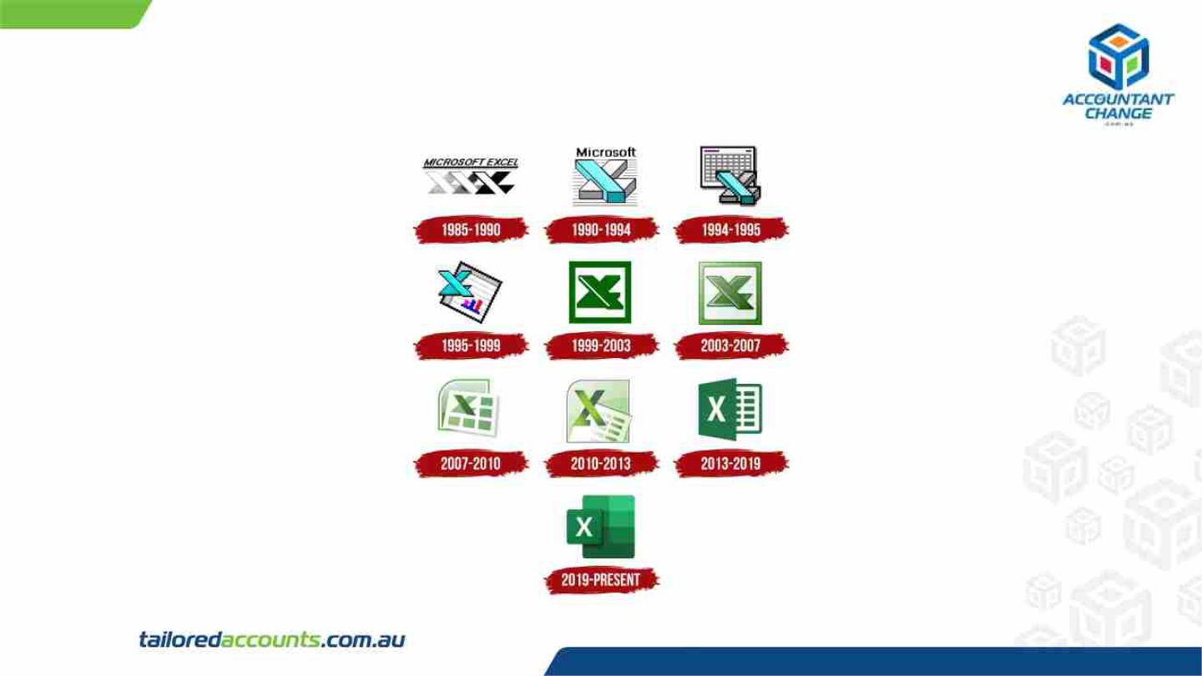
Excel History

Slide 8

Spreadsheet
• Accounting software is getting more
advanced = they prepare reports etc
• So do we need to be able to use
Excel/Google sheet as a future accountant?

Slide 9
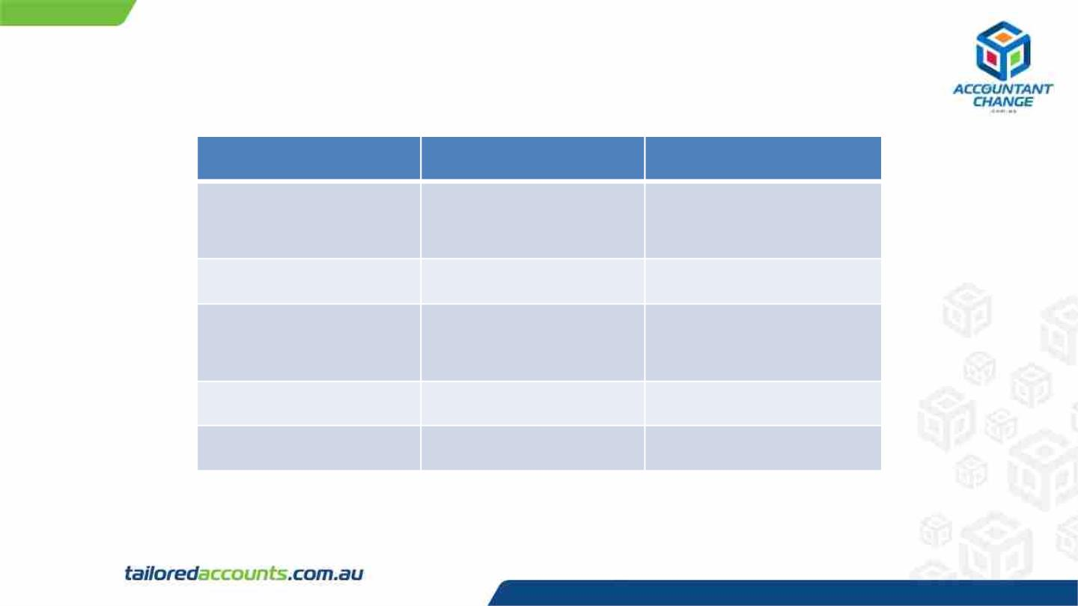
Excel (Desktop) vs Google Sheet
Excel
Google Sheet
Data location
Collaboration
Desktop/Cloud
Cloud (can be
used offline)
Good
Good
Good
Good
Complicated
Formulas
Security
Costs
Very Good
Not Free
Very Good
Free
Except a few differences – Both are good software!

Slide 10

Spreadsheet Skills - Myth
• Accountants do not need spreadsheet any more
• You have to remember all the formulas to work on excel,
otherwise you are not good at excel
• There is one correct formula – nothing else works
• Advanced users of excel always get the formula right from
their first attempt

Slide 11
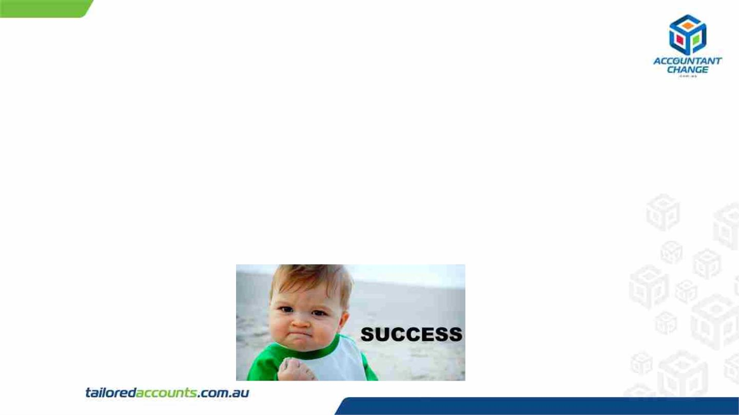
Spreadsheet Skills - My Opinions
• Think about the logic
• What do you want to achieve?
• How do you want to create conditions?
• Try the formula
• If all looks fine – it is good to go
• If something is wrong – go back to step 1

Slide 12
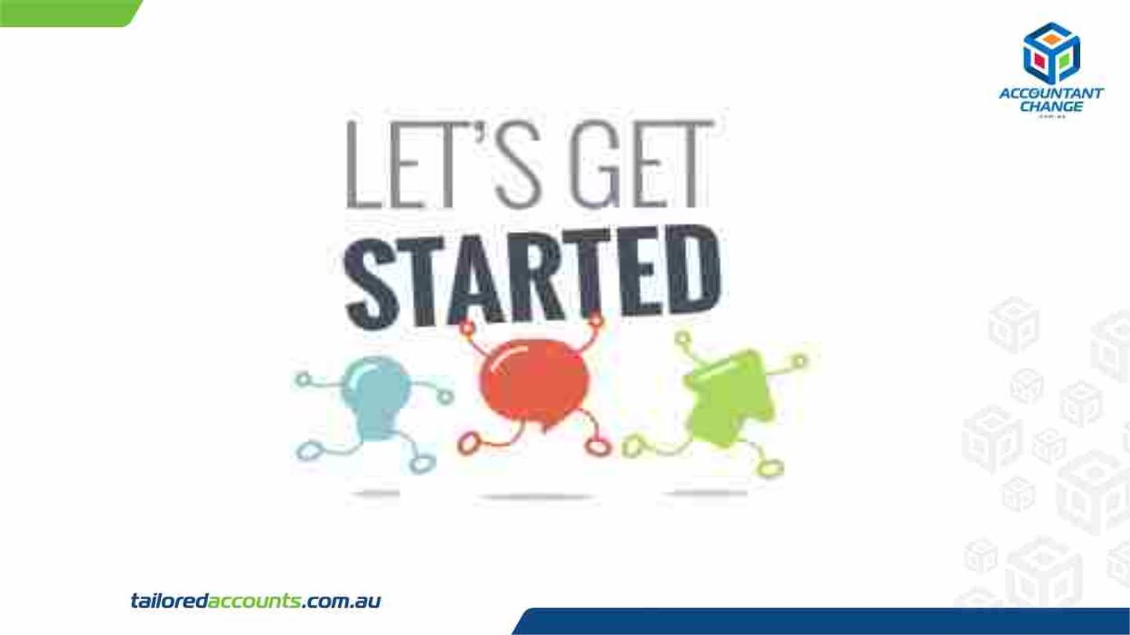

Slide 13
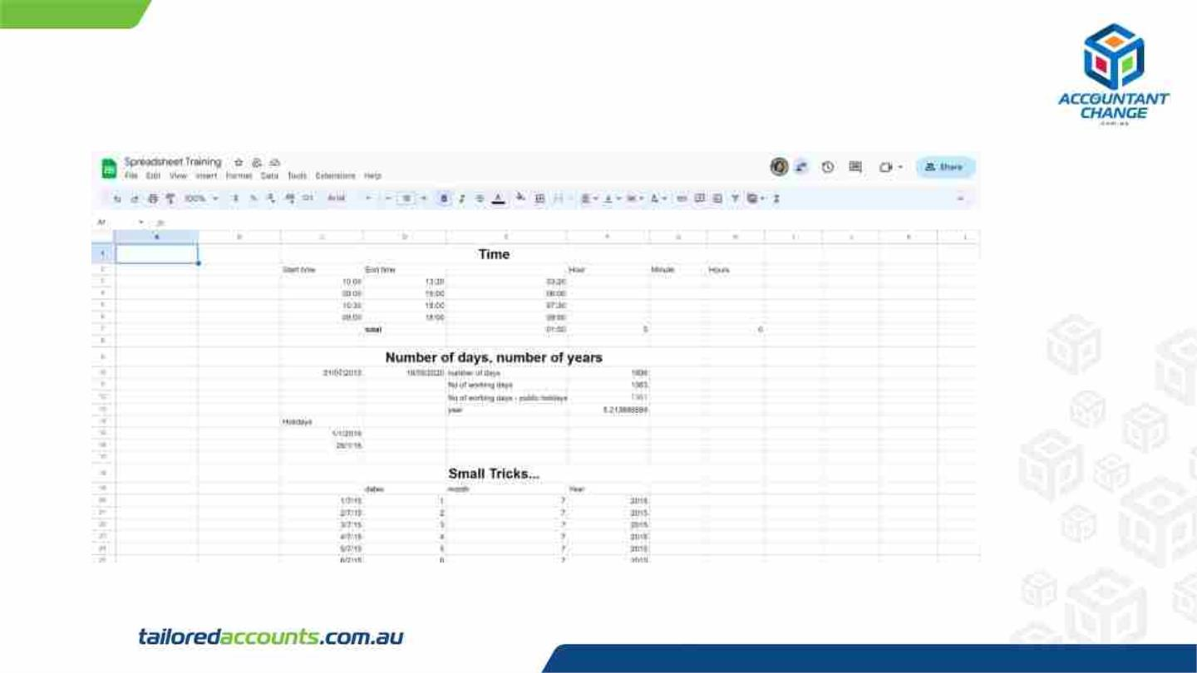
Spreadsheet Training

Slide 14
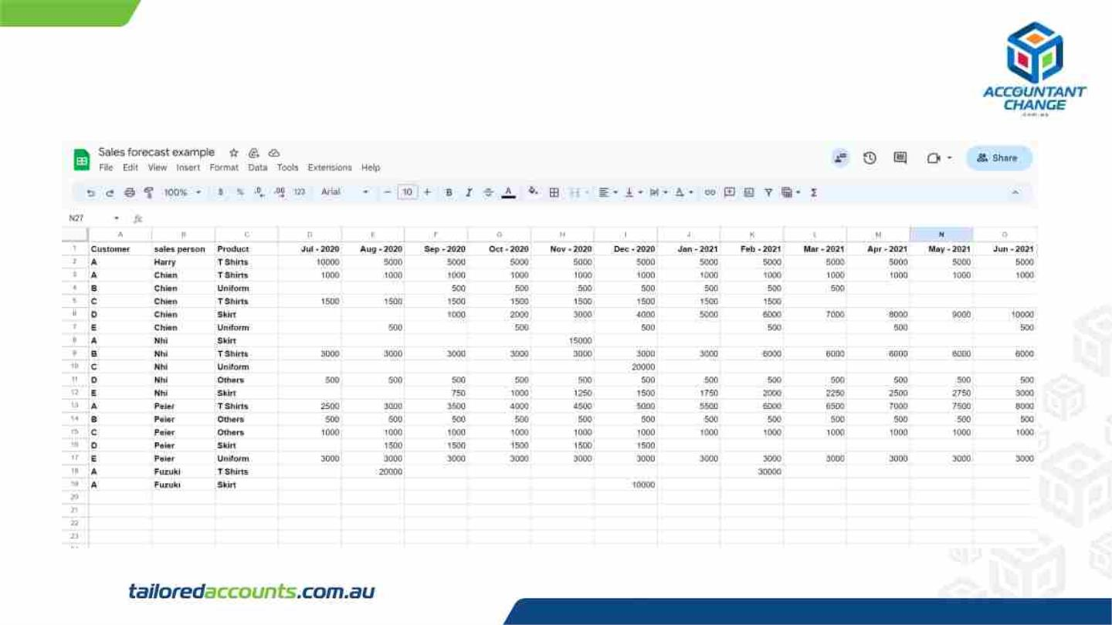
Sales Forecast Example

Slide 15
A Few Recaps & Tips
• Accountants still need spreadsheet (for a while at least)
• More formulas you are familiar with, the better you can work
with - but not necessary to know everything
• If you are not sure about functions, self-research is a key
• Most of things that you want to achieve – you can probably
achieve in spreadsheet

Slide 16

Any Questions?

Slide 17
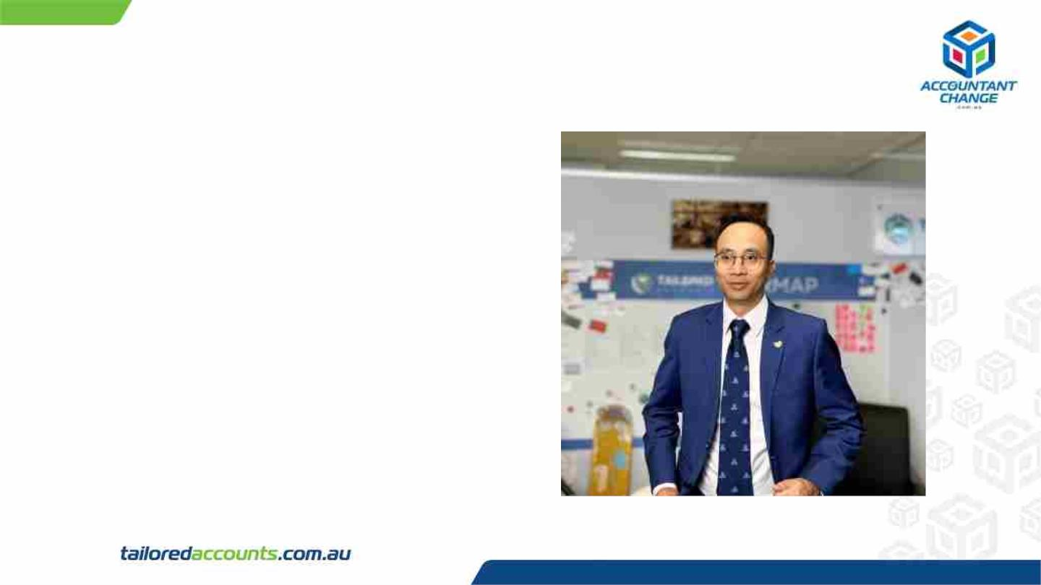
Harry Hoang
CEO and Founder of Tailored Accounts since 2008.
Fields of Interest:
✔ Accounting;
✔ Start-up mentorship;
✔ Business coaching.
Current volunteer positions:
✔ Organiser of AccountantChange Training Program;
✔ Mentor at The Mill House Accelerator Program;
✔ Business coach and sponsor at Innovation ACT;
✔ Mentor at the Griffin Accelerator Start-up Program.

Slide 18

XERO 101:
The Beginner’s Guide to
Mastering XERO

Slide 19

Thank You

Slide 20

Follow us
@AccountantChange
@Tailored Accounts
@AcctChange2018
@Tailored Accounts

