Slide 1


WELCOME TO ACCOUNTANTCHANGE TRAINING SEMINAR
30 September 22

Slide 2

About Tailored Accounts
Founded by Harry Hoang in 2008, Tailored Accounts is now one of Australia’s leading management accounting and consulting companies, with offices located in Brisbane, Sydney, Goulburn and Canberra.
Services:
Management & compliance accounting, taxation.
Cloud integration;
Business advisory.
Clientele – more than 200 companies and not for profit associations throughout Australia.

Slide 3

About The Speaker

Slide 4
Bryan Nguyen & Candice Chen
Bryan Nguyen
Accountant
Education:
Bachelor’s degree in Accounting and Finance
Post-graduate in Accounting Information Systems
Fields of Interest:
Accounting and Finance
Technologies to improve productivities, workflows etc.
Start-up businesses
Candice Chen
Tailored Accounts Intern
Education:
Bachelor’s degrees in International Relations & Accounting
Currently completing a Masters of Project Management
Notes:
https://prezi.com/view/Dq4v1QS5TDAKX74N1kLf/

Slide 5


Xero & Dext
Xero Accounting Software
Flexible features
  Bank reconciliation
  AR/AP
  GST returns
  Payrolls
  Etc.
Dext
- Accounting toolkit
- More efficient workflows
- More accurate data extraction

Slide 6
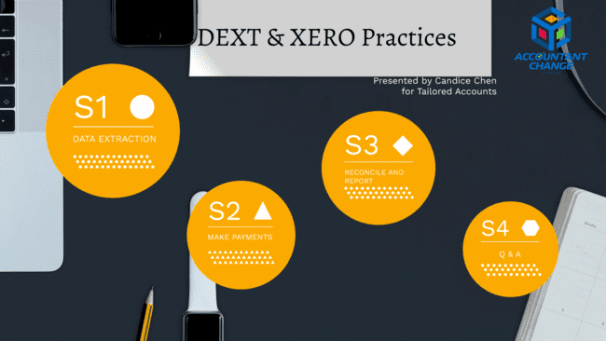
Notes:
https://prezi.com/view/Dq4v1QS5TDAKX74N1kLf/

Slide 7


Blockchain & Cryptocurrency: Impact on our Future Careers
PRESENTATION
Friday 30th September @ 10:15 – 11:00am
David Elliot
Executive Director
Agile Digital
CPA Canberra
30 September 2022
Version 1.0

Slide 8
Overview
Introduction
Agile Digital & Our Blockchain Story
What is Blockchain technology?
What is a Cryptocurrency?
The Social & Economic Story of Blockchain
The Governance Story of Blockchain
The Environmental Story of Blockchain
What all this Means for your Career
Questions

Slide 9

Introduction
David Elliot, Executive Director @ Agile Digital
David spent his youth delivering digital platforms across the UK and Canada. After this he founded Australian software development consultancy, Agile Digital.
Agile Digital brings together the best developers and software engineering methods to build big digital platforms for businesses and government.

Slide 10

Our Blockchain Story
Agile Digital has been an Australian innovator in the application of blockchain (distributed ledger) technologies since 2017.
2019 – AIIA National Award Winner in ”Public Sector & Government" and the Australian Blockchain Industry Award for "Best Government Project" with IP Australia for demonstrating supply chain provenance via Blockchain (the Smart Trade Mark).
2018 – AIIA National Award Runner-Up for "Big Data Innovation of the Year" with the Australian Commonwealth Department of Health for a health data research management framework backed by Blockchain.
2017 – International Award Winner at Asia-Pacific Economic Cooperation (APEC) Trade Ministers' Summit for the application of Blockchain to international supply chain integrity.

Slide 11
What is a Blockchain / DLT?
”
A Blockchain is a technology that can serve to maintain a ledger of financial information and govern the transfer of asset ownership in a safe and verifiable manner.
This technology is special because the ledger is governed by consensus (rather than a central party) and the assets it records ownership for are digital assets.
Blockchain/DLT technologies offer benefits to business and the economy broader than just cryptocurrencies. You can think of this space as the “Internet of Trust”
There are a wide variety of Distributed Ledger Technologies & services that offer value beyond cryptocurrencies, including:
Ethereum – offers ‘solidity’ smart contracts. Recently moved to ‘proof of stake’ mining to reduce environmental impact.
NFTs – the utility of digital assets.
Zero Knowledge Proofs - Obfuscate confidential data that can still be validated.
01
DIGITAL IDENTITY
03
OPEN STANDARDS
A verifiable marketplace needs:
a) Decentralised identifiers (DIDs)
b) Vendor/Supplier Reputation
c) Non-Repudiation of Transactions
A global marketplace needs:
a) Distributed Rules of Consensus
b) Common Data Standards
c) Shared & Permissioned Protocols
02
RECORD KEEPING
04
SMART CONTRACTS
An auditable marketplace needs:
a) Assurance of Data Integrity
b) History of (all) Transactions
c) Distributed Custodianship
A scalable marketplace needs:
a) Real-Time Action
b) Rewards for Reliability
c) Oracles!

Slide 12
What is a Cryptocurrency?
USES OF A CURRENCY
NATURE OF A CURRENCY
Store of Value – a currency can be used to store value over time.
Medium of Exchange – a currency can be used in exchange for goods or services.
Unit of Account – can be used to settle a debt with a regulatory authority.
Durable – lasts for a long time.
Divisible – big units can be divided into smaller units.
Portable – easily transported from A to B.
Fungible – tokens of the same value are interchangeable (treated the same).
Limited – supply is constrained, and tokens are very hard to counterfeit.
CRYPTOCURRENCY – a cryptographic technology that exhibits the nature of (and ideally the uses of) a currency in the digital world.

Slide 13
The Social & Economic Story
01
02
03
WHY WAS BITCOIN FOUNDED?
IS FINANCIAL AUTONOMY / ANONYMITY A HUMAN RIGHT?
HOW CAN A TECHNOLOGY CHANGE SOCIETY?
‘Satoshi Nakamoto’ founded Bitcoin is response to the 2008 financial crisis as an alternative to central banking. The Genesis Block referenced an article about banking bailout.
Should we be able to spend our money without restrictions or surveillance?
Some technologies change the way society itself works...

Slide 14
The Governance Story
Future Sight
We advise on our client’s best digital future by seeing what others often can’t see.
03
01
02
Sustainable Foundations
We build sustainable futures by engaging to uplift people, methods, and methodology.
WHY DECENTRALISATION IS A BIG DEAL
SMART CONTRACTS
PROVENANCE
The way economic systems can be governed without a central authority is key to understand.
Software is very good at enforcing rules. The hard part is describing rules that are unambiguous without the ‘grey edges’ of analog contracts.
The world is re-gearing to ESG awareness and compliance. DLT may be key to reliably measuring Scope 2 and Scope 3 impacts.

Slide 15
The Environmental Story
01
Future Sight
We advise on our client’s best digital future by seeing what others often can’t see.
03
02
Sustainable Foundations
We build sustainable futures by engaging to uplift people, methods, and methodology.
CAN WE EVER HAVE SUSTAINABLE CRYPTO?
BLOCKCHAIN TO ACHIEVE SUSTAINABILITY GOALS
CONDITIONAL DONATIONS TO NONPROFITS
Recent changes to the Ethereum protocol suggest yes.
Environment impacts must be dealt with with trust technology.
Uses in the NFP sector.

Slide 16
What this all Means for your Career
01
02
03
THE ‘FINTECH’ SECTOR
TECHNOLOGIES
JOBS IMPACT
There is a whole new alternative to the banking system on the rise.
The sector offers:
protections against fraud and misrepresentation.
You’re in the best position to get in at the ground floor.
Web3
Crypto
Cyber
‘Data translation’ jobs on the way out due to automation of transactions with reduced error rates on both sides of the transaction.
Auditing of smart contracts and oracles.
Regulations and tax for transactions that aren’t constrained by sovereignty.

Slide 17
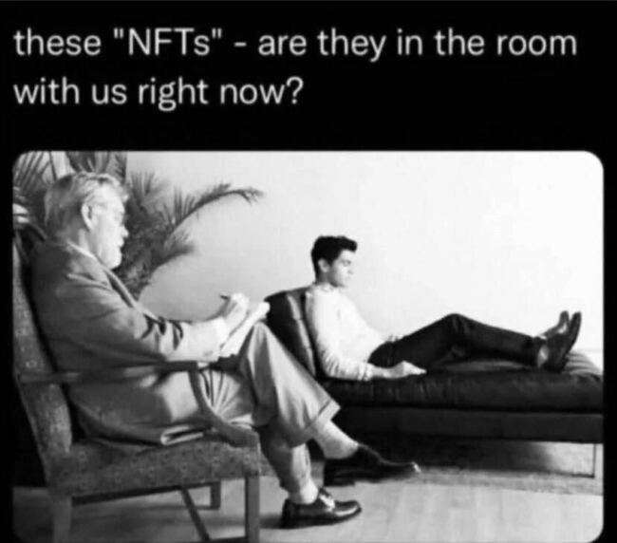
Questions?

Slide 18
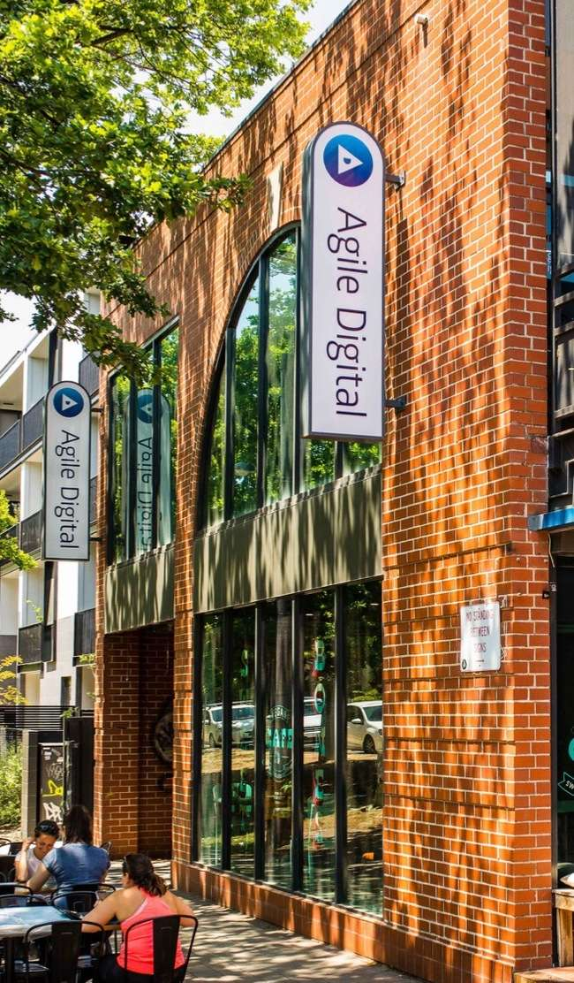
Thank you
AccountantChange Presentation
30 September 2022

Slide 19

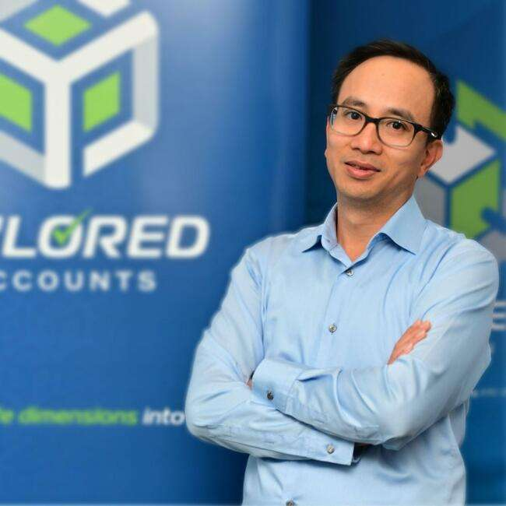
Harry Hoang
CEO and Founder of Tailored Accounts since 2008.
Fields of Interest:
Accounting;
Start-up mentorship;
Business coaching.
Current volunteer positions:
Organiser of AccountantChange Training Program;
Mentor at The Mill House Accelerator Program;
Business coach and sponsor at Innovation ACT;
Mentor at the Griffin Accelerator Start-up Program.

Slide 20
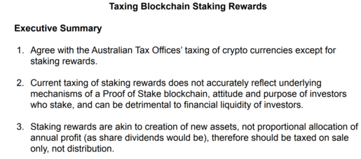

Slide 21
Links to
Taxing Blockchain Staking Rewards Series
Taxing Blockchain Staking Rewards (Part 1 of 3):
http://tailoredaccounts.com.au/news-media/bookkeeping-and-business-news/taxing-blockchain-staking-rewards-part-1-of-3
Taxing Blockchain Staking Rewards (Part 2 of 3):
https://tailoredaccounts.com.au/news-media/bookkeeping-and-business-news/taxing-blockchain-staking-rewards-part-2-of-3
Taxing Blockchain Staking Rewards (Part 3 of 3):
https://tailoredaccounts.com.au/news-media/bookkeeping-and-business-news/taxing-blockchain-staking-rewards-part-3-of-3
Interested in getting the latest advice and news on what’s going on in the industry?
Tailored Accounts has a weekly newsletter!
Subscribe now.

Slide 22
Thank You

Slide 23

Follow us
@AccountantChange
@Tailored Accounts
@AcctChange2018
@Tailored Accounts

